Slide 1

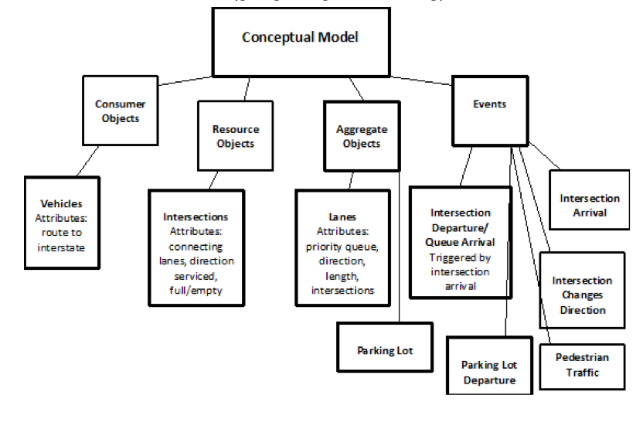
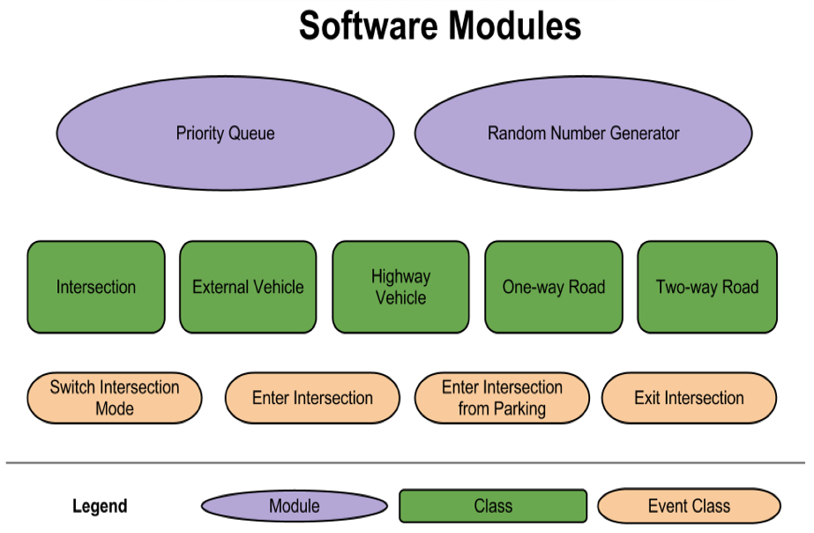
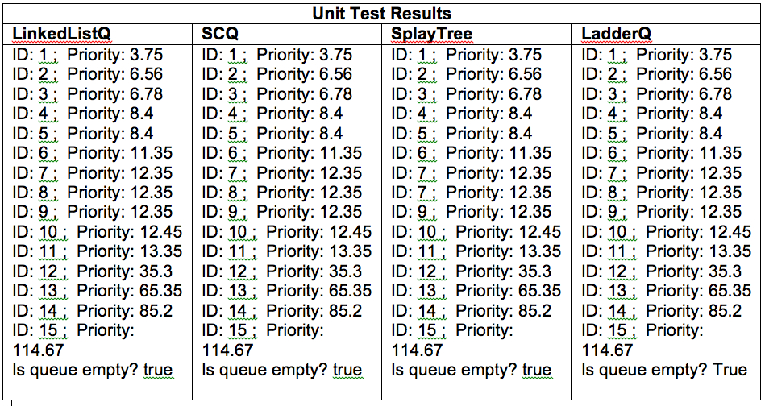
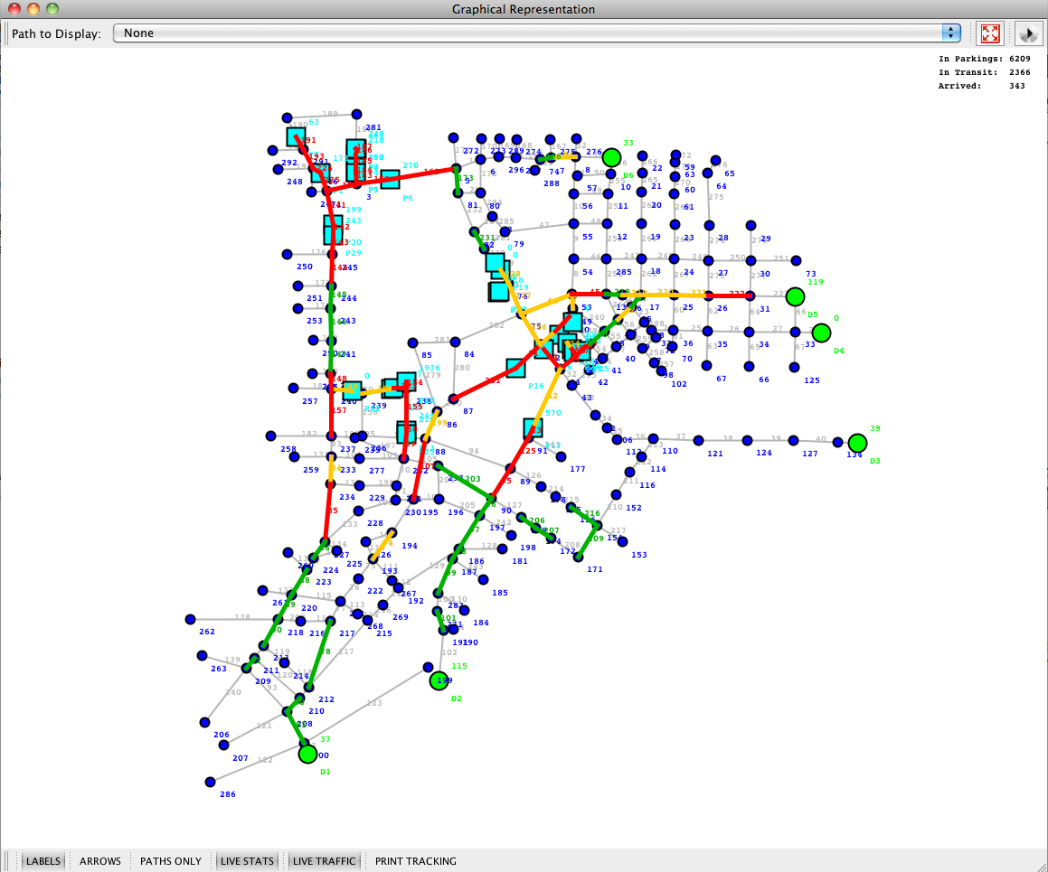
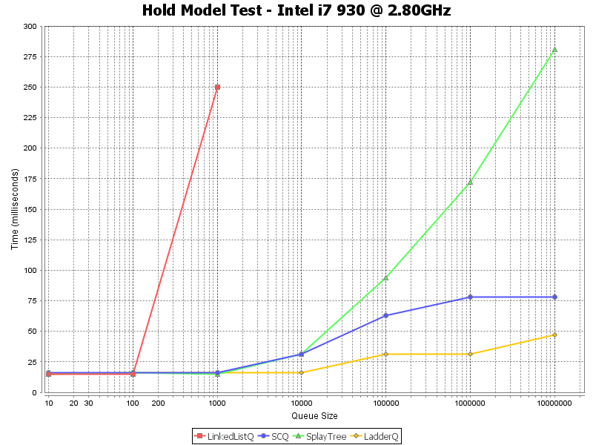
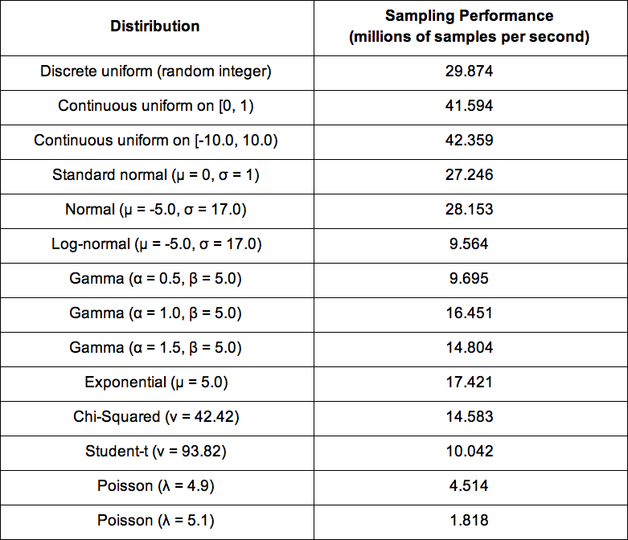
CSE 6730 Project 1: Transportation System Simulation
Anita Zakrzewska¹, Borja Zarco², Marat Dukhan¹ and Yiwei Cheng²
¹ School of Computational Science and Engineering, Georgia Institute of Technology, Atlanta, GA, USA
² School of of Civil and Environmental Engineering, Georgia Institute of Technology, Atlanta, GA, USA
anzakrz@gmail.comborjazarco@gatech.edu, maratek@gmail.com, yiweicheng@gmail.com
1. Abstract
2.1. Conceptual Model
We developed a transportation system model to investigate traffic routing plans will efficiently route vehicular traffics from parking lots near the Georgia Dome, Atlanta, GA, to the major interstates (i.e. I-20, I75/I85). Specifically, for each routing strategy, we simulate flow of traffic from the parking lots to interstate entrances following the conclusion of a football game to determine the average delay for a car to reach the entrance. Vehicular flows along road segments are modeled as discrete events with priority queue implementation. For this study, accuracy and performance of four priority queue structures (i.e. linkedlist, splaytree, calendar queue and ladder queue) were tested and the ladder queue implementation was chosen. To model vehicles in the parking lots, a random number generator based on known and tested algorithms for normal and gamma variates were utilized. In this study, two routing strategies are investigated: (A) Vehicles directed along shortest paths to the interstate entrance, depending on their destination interstate. (B) As a possible improvement to Strategy 1 with some modification to the paths. For each strategy, we ran the simulation for 1000 times to obtain average delay for each strategy. Results show that Strategy (A) is still better than Strategy (B).
Assumptions:
1. Once individuals reach the interstate entrance, they travel freely to final destination.
2. No road accidents.
3. Vehicles follow designated shortest paths.
4. Occupancy of a parking lot is random.
5. External traffic follow random process.
6. Vehicles travelling at uniform speed.
7. Vehicles are of average length of 4m.
3. Data
Figure 1. Schematic of the conceptual model.
(a). Road Segments
Traffic direction
Number of lanes in each direction
Length of segment
Two bounding roads
Two intersections on either end
(b). Intersections
Latitude
Longitude
Whether intersection is a destination
(c). Parking Lots
Capacity
The intersection at the exit
(d) Paths from each parking lot to the interstate entrance
2.2. Software
Modeled Objects
Intersections: Nodes connecting road segments
Road: Contain list of lanes which are priority queues.
Parking lot: Source of vehicles, with finite capacity and random occupancy.
Path: List of roads from a parking lot to destination.
Vehicles: Routed from parking lot to entrance.
Modeled Events
Intersection arrival: New vehicle arrives at intersection from road.
Intersection departure: Vehicle leaves intersection and is added to a lane in the next road.
Intersection direction change: Switch the serving direction of the intersection.
Parking lot departure: Vehicle leaves parking lot and enters the connecting intersection.
Pedestrian traffic: Modeled implicitly by intersection direction changes.
Figure 3. Parking lot exits and interstate entrances on Google map.
Figure 2. High level description of the software modules.
4. Unit and Performance Tests
5. Simulation
Priority Queues
We perform unit tests and performance tests on four priority queue structures: linked list, splay tree, sorted-discipline calendar queue and the ladder queue.
For the unit tests, we utilize a model that consist of enqueue and dequeue operations. Fifteen events are initialized with random priorities and indices. First the events are enqueue. Next, events with smallest priority are sequentially dequeued until priority queue is empty. Results shown in Figure 4 (top).
We utilize the hold model to measure the performance of the priority queues. We evaluate the average operation time for queue sizes ranging from 10 to 10000000 to obtain performance cure for each priority queue (Figure 4, bottom).
Base on the unit test and performance test results, we choose the Ladder Q as the main form of priority queue that we implement in the traffic simulation model.
We investigate the efficiency of two routing strategies:
Vehicles directed along shortest paths to the interstate entrance, depending on their destination interstate. All I-75 bound vehicles are routed to the nearest I-75 entrance regardless of whether they are northbound or southbound.
(B) This routing plan is formulated base on the following ideas: (1). To route cars from parking lots so that the drive near other parking lots' exits as little as possible. (2). To route cars from parking lots around the congested areas even if this will result in longer paths. (3). To make some roads (especially near the parking lot exits) one-way to increase the possible bandwidth.
For each strategy, we ran the simulation 1000 times and collect data on average delay time of the vehicles for each run.
Random Number Generator
Random number generator based on MT 19937 (Matsumoto and Nishimura,1998) and Marsaglia-Tsang (2000) algorithms for normal and gamma variates.
Units Tests:
Continuous uniform [0,1) variates always in [0,1) range.
Continuous uniform [a,b) variates always in [a,b) range.
Log-normal variates never less than zero.
Gamma variates never less than zero.
Exponential variates never less than zero.
Chi-Squared variates never less than zero.
Poisson variates never less than zero.
Pearson Chi-squared test to validate statistical properties of variates.
Chi-Squared test for Poisson distribution.
Performance Test:
Measure time to generate 1000000 variates. Results shown in Figure 5.
Strategy A
Figure 6. The graphical user interface of the model.
Figure 4. (Top) Priority queue unit test results. (Bottom) Priority queue performance test results.
Strategy B
Figure 5. Random number generator performance test results.
6. Conclusion
The traffic system model successfully simulated traffic flows along road networks in downtown Atlanta, Georgia.
The model is able to route all the vehicles from the parking lots to the highway entrances following both prescribed routing strategies. E.g. no deadlocks, no cars stuck in the road networks.
Strategy A is statistically better than Strategy B.
Strategy B failed because: (1) we did not route vehicles far away enough from congested areas, (2) increased path lengths, and (3) forcing some existing roads to be one way.
Caveats: For both routing strategies, the average delay time is a little high: in the order of ~1.5 - 2hrs.
Can be due behavior of traffic on roads. Cars within the same road do not change lanes, even if the adjacent lane is empty while its lane is jammed.
Can also be due to behavior at the intersections. The intersection is behaving like a traffic light. It won’t switch direction even if the road has no vehicles.
Most paths have evacuation time of less than 1hr, a few that is shared by many parking lots caused the average delay time to increase to ~1.5 – 2 hrs.

